Slide 1

BHARATI VIDYAPEETH (DEEMED TO BE UNIVERSITY)
COLLEGE OF ENGINEERING, PUNE
Department of Computer Engineering
B.TECH. MAJOR PROJECT
EstiMate: Project Cost & Resource Estimation Platform
Topic: Cost Estimation | Finding out how much money, time and how many people a software project needs
Submitted by:
1. Suraj Keshri – PRN: 2314110138
2. Vivek Kumar – PRN: 2314110142
3. Nyasa Kaushal – PRN: 2314110136
4. Manas Jha – PRN: 2314110134
Project Guide:
Prof. S.B. Wakurdekar
Academic Year:
2026–27
Project Presentation | Final Year Major Project Review

Slide 2
Presentation Roadmap
01
02
03
Why this project
Aim and Scope
Our System
The problem and our idea
What we build and what we skip
Features, flow and tools
04
05
06
How numbers are worked out
Results and Testing
Conclusion
Effort, team, cost and price – step by step
Screenshots, example runs, checks
Limits and future work
Department of Computer Engineering | B.Tech. Major Project
2

Slide 3
Introduction / Background
Many software projects cost more money or take more time than planned
Often the reason is a weak estimate: one guessed number with no notes
EstiMate takes the project details and gives the effort, the team plan, a cost range and a price
It also lists the assumptions behind the numbers
Useful for companies, startups and freelancers who must quote a price
P50 · P80 · P95
three cost levels, from likely to very safe
6 roles
backend, frontend, QA, DevOps, design, project manager
5 phases
Requirements, Design, Implementation, Testing, Deployment
Big idea: show cost as a range, and show every step of the working.
Department of Computer Engineering | B.Tech. Major Project
3

Slide 4



Problem Statement & Motivation
One number, no range
People × time is not simple
Assumptions get lost
Someone says “it will cost 40 lakh”. Does that mean 35 to 45 lakh, or 25 to 90 lakh? Nobody knows.
Total work is not the same as team size. A project needs few people at the start, many in the middle and few at the end.
The estimate assumed some things, such as the rate per person. Later nobody remembers them, and the team gets blamed.
Need: a simple tool that shows the work, the team, the cost range and the price in one place, with the assumptions written down.
Impact: a price you can explain – cost, reserve, profit and assumptions are all visible.
Department of Computer Engineering | B.Tech. Major Project
4

Slide 5
Aim, Objectives & Scope
AIM: Build a website that turns project details into effort, a team plan, a cost range and a client price.
1 · Effort & Phases
2 · Team Plan
3 · Cost Range
4 · Price & Notes
Work out total effort and split it into 5 phases.
Show how many people of each of 6 roles are needed over time.
Show cost at three levels: P50, P80 and P95.
Add reserve and margin to get the price. List the assumptions.
What we build
What we do NOT build
Effort and effort-by-phase view
Team-over-time chart for each role
Cost range, reserve, margin and price
Assumptions list
Task boards or time sheets
Billing or accounts
An AI that guesses the number – all numbers come from maths
Department of Computer Engineering | B.Tech. Major Project
5

Slide 6




Proposed System
Project details
Effort and phases
Team over time
User gives the project type (for example, E-commerce platform) and the duration.
Total effort in person-months, split into Requirements, Design, Implementation, Testing, Deployment.
Area chart by role: backend, frontend, QA, DevOps, design, project manager.
Cost range
Reserve and price
Assumptions list
P50, P80 and P95 cost, plus contingency (money for known risks).
Adds a management reserve and a 30% margin to get the client price.
Shows project, total cost, effort, team size, duration and cost per person-month.
All six parts appear together in one Results panel.
Department of Computer Engineering | B.Tech. Major Project
6

Slide 7
System Architecture / Block Diagram
1. Project details
type (E-commerce platform), duration
2. Calculation logic
effort → phases → team → cost → price
3. Results panel
React screen that shows everything
The Results panel shows four sections:
Staffing over time
area chart by role
Where the effort goes
effort for each phase
Price
P50/P80/P95, reserve, margin
Assumptions
project, cost, effort, team, duration
In simple words
You type in the project details. The tool does the maths step by step. Then one panel shows the team chart, the effort by phase, the cost range, the final price and the list of assumptions.
Department of Computer Engineering | B.Tech. Major Project
7

Slide 8
Methodology / Workflow
1 Details
2 Effort
3 Phases
4 Team
5 Cost range
6 Reserve
7 Price
Project type and duration
Total work in person-months
Split work into 5 phases
People per role over time
P50, P80, P95 cost
Add money for surprises
Add 30% margin
▶
▶
▶
▶
▶
▶
RESULT: effort by phase · team over time · cost range · client price · assumptions
Each step feeds the next
Same input, same answer
The effort sets the cost. The cost sets the reserve and the price. The phase split and team chart come from the same effort.
In two runs with the same project details, the cost was the same (P50 = ₹16,510).
Department of Computer Engineering | B.Tech. Major Project
8

Slide 9
Key Terms Explained
Term | Meaning | Term | Meaning
Person-month (PM) | Work done by 1 person in 1 month. 1.6 PM is a little more than one person for one month. | P50 / P80 / P95 | P50 = likely cost. P80 = safer. P95 = very safe. Higher P = more money.
Duration | How many months the project takes. | Contingency | Extra money kept for risks we already know about.
Average team size | How many people work on average during the project. | Management reserve | Extra money (about 5.5%) kept for surprises.
Cost per person-month | Money for one person for one month. Our tool uses ₹10,000. | Internal cost | Estimated cost + management reserve. What it costs us.
Phases | Requirements: what to build. Design: plan it. Implementation: write code. Testing: fix errors. Deployment: put it live. | Margin | Profit added on top of our cost. We use 30%.
Roles | Backend (server code), Frontend (screens), QA (testers), DevOps (setup and running), Design (look), PM (planning). | Client price | Internal cost + margin = internal cost × 1.30.
Rayleigh curve | A bell shape: team starts small, grows to a peak, then becomes small again. | Assumptions | The facts the numbers are based on, written down.
Department of Computer Engineering | B.Tech. Major Project
9

Slide 10
Step 2 & 3 – Effort and Phases
In simple words: Effort is the total work needed, counted in person-months. In our example run it is about 1.6 PM. This work is then divided over 5 phases using fixed shares.
Phase | Share of effort | Example (260 total)
Requirements | 10% | 26
Design | 15% | 39
Implementation | 50% | 130
Testing | 20% | 52
Deployment | 5% | 13
How we calculate
Phase effort = total effort × phase share
Implementation: 260 × 50% = 130
Testing: 260 × 20% = 52
Design: 260 × 15% = 39
Check: 26 + 39 + 130 + 52 + 13 = 260
In simple words: Most of the work (half) is writing the code. The shares add up to 100%.
Department of Computer Engineering | B.Tech. Major Project
10

Slide 11
Step 4 – Team Over Time (Rayleigh Curve)
In simple words: A real project does not use the same number of people every month. The team starts small, grows to a peak near the middle (around 40% of the time), then becomes small again. The curve looks like a bell.
How we calculate each role's share
Total of role peaks (example) = 19.5 + 18.1 + 11.7 + 6.4 + 5.3 + 3.9 = 64.9
Backend share = 19.5 ÷ 64.9 = 30%
Frontend = 18.1 ÷ 64.9 = 28%
QA = 11.7 ÷ 64.9 = 18%
Design = 10%, DevOps = 8%, Project manager = 6%
Shares add up: 30 + 28 + 18 + 10 + 8 + 6 = 100%
Why this matters
Backend and frontend developers are needed the most. A longer duration means a smaller team at any time, but the total work stays the same.
Department of Computer Engineering | B.Tech. Major Project
11

Slide 12
Step 5 – Cost Range (P50, P80, P95)
In simple words: Cost is not one number. P50 is the likely cost. P80 is safer. P95 is very safe. We show P80 as the estimated cost.
How we calculate (example run)
Cost per person-month = ₹10,000
P50 = effort × 10,000 → about 1.65 × 10,000 = ₹16,510
P80 = P50 × 1.25 = 16,510 × 1.25 = ₹20,638
P95 = P50 × 1.5625 = 16,510 × 1.5625 = ₹25,797
Second run: 17,129 × 1.25 = 21,411 and × 1.5625 = 26,764 (same pattern)
Contingency shown by the tool: ₹3,250
In simple words: Contingency is extra money for risks we already know about. It is kept inside the project budget.
Department of Computer Engineering | B.Tech. Major Project
12

Slide 13
Step 6 & 7 – Reserve, Margin and Price
Estimated cost
P80 cost
+ Reserve
about 5.5% for surprises
= Internal cost
what it costs us
Client price
internal cost × 1.30
▶
▶
▶
How we calculate (example run)
1. Estimated cost (P80) = ₹20,638
2. Management reserve = ₹1,138 (about 5.5% of 20,638)
3. Internal cost = 20,638 + 1,138 ≈ ₹21,775
4. Margin = 30% × 21,775 = ₹6,533
5. Client price = 21,775 + 6,533 = ₹28,308 (same as 21,775 × 1.30)
In simple words: Margin is profit added on top of our cost. The tool rounds each value, so totals can differ by ₹1.
Department of Computer Engineering | B.Tech. Major Project
13

Slide 14
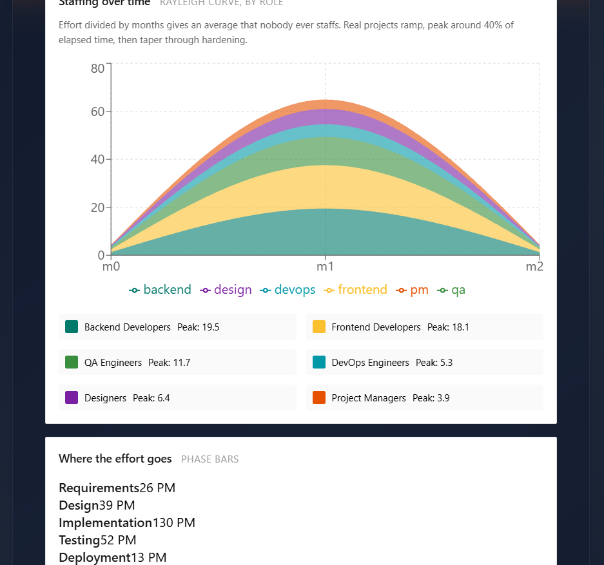
Implementation – Team and Effort Output
Staffing over time
Area chart by role. The curve rises, peaks near the middle and falls. Legend shows the peak of each role (Backend 19.5, Frontend 18.1, QA 11.7).
Where the effort goes
One line for each phase: Requirements 26, Design 39, Implementation 130, Testing 52, Deployment 13.
In simple words: This is the real output of our project for an E-commerce platform. Hovering on the chart shows the number of people of each role in that month.
Department of Computer Engineering | B.Tech. Major Project
14

Slide 15
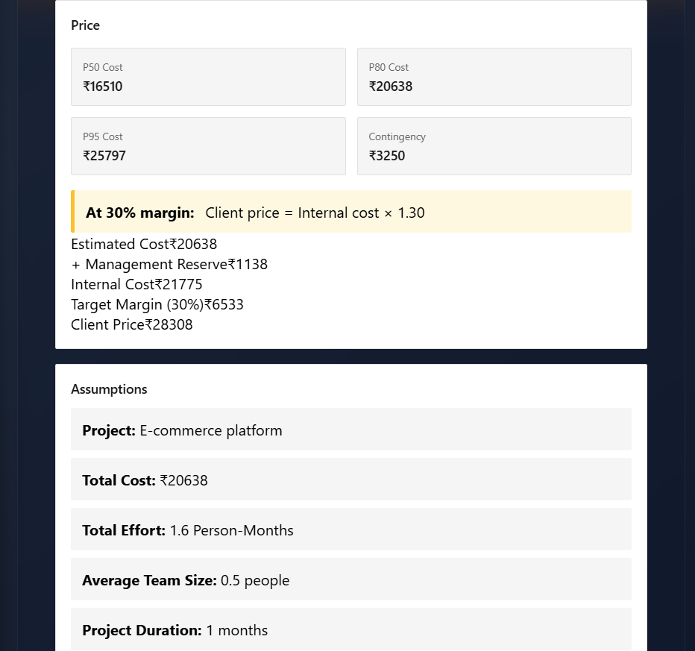
Implementation – Price and Assumptions Output
Price section
Shows P50 ₹16,510, P80 ₹20,638, P95 ₹25,797 and contingency ₹3,250. Below it: reserve ₹1,138, internal cost ₹21,775, margin ₹6,533 and client price ₹28,308.
Assumptions section
Lists the project (E-commerce platform), total cost, total effort (1.6 PM), average team size, duration and cost per person-month (₹10,000).
In simple words: Every number on the price is explained on screen, so a client can see how the final price was made.
Department of Computer Engineering | B.Tech. Major Project
15

Slide 16




Technology Stack & Tools
React
TypeScript
Builds the screens. Our Results panel is a React component (ResultsPanel).
JavaScript with types. It catches many mistakes before the app runs.
Interactive charts
Browser DevTools
Area chart for the team plan with a hover box that shows each role's value.
Used to test the app and read error messages in the console.
Language: TypeScript (.tsx files) · Screens: React · Testing: browser console
Department of Computer Engineering | B.Tech. Major Project
16

Slide 17
System Design – Results Panel
ResultsPanel
Input
Staffing over time
Rayleigh curve, by role
Project type, duration and cost per person-month (₹10,000).
Where the effort goes
5 phases
Output
Total effort, phase effort, role-wise staffing curve, cost range and price.
Price
P50, P80, P95, contingency, margin, price
Design choice
Assumptions
6 facts about the project
All results sit on one screen, one card per section, so the whole estimate can be read top to bottom.
Department of Computer Engineering | B.Tech. Major Project
17

Slide 18

Testing Strategy
Check the maths
Try different inputs
Read the console
We re-did the calculations by hand and compared them with the tool.
We ran the same project with 1, 2 and 3 months and compared the results.
Browser console shows errors that the screen does not show.
Test case | Expected | Actual | Status
P50 ≤ P80 ≤ P95 | 16,510 ≤ 20,638 ≤ 25,797 | Same | Pass
Internal = cost + reserve | 20,638 + 1,138 = 21,776 | 21,775 | Pass (₹1 rounding)
Price = internal × 1.30 | 21,775 × 1.30 = 28,307.5 | 28,308 | Pass
Phases add up | 26+39+130+52+13 = 260 | 260 | Pass
Duration only changed | Same cost | ₹16,510 in both runs | Pass
Issue found: the console showed that formatHours stopped when a value was missing (toFixed on undefined). Fix: use 0 when the value is missing.
Department of Computer Engineering | B.Tech. Major Project
18

Slide 19
Results & Discussion
E-commerce platform | Run 1 | Run 2 | Run 3
Duration | 1 month | 2 months | 3 months
Total effort | 1.6 PM | 1.6 PM | 1.7 PM
P50 cost | ₹16,510 | ₹16,510 | ₹17,129
P80 cost | ₹20,638 | ₹20,638 | ₹21,411
P95 cost | ₹25,797 | ₹25,797 | ₹26,764
Contingency | ₹3,250 | ₹3,250 | ₹3,372
Client price | ₹28,308 | ₹28,308 | ₹29,369
Average team size | 0.5 | 0.3 | 0.3
In simple words: Costs follow effort. Duration changes only the team size.
Values are taken from the tool's own output screens (see slides 14 and 15).
Observation: same effort gives the same cost; a longer duration gives a smaller team.
Department of Computer Engineering | B.Tech. Major Project
19

Slide 20
Project Plan & Contributions
Completed in the project
Challenge | How we handle it
Chart looks flat for very small projects | Show values more carefully for tiny teams
Units shown as hours and PM | Use one clear unit label
Console error when a value is missing | Use 0 as default value
✔ Project details and effort
✔ Effort split into 5 phases
✔ Team curve for 6 roles
✔ P50 / P80 / P95 cost
✔ Reserve, margin and client price
In simple words: We found these problems by running the tool with different inputs and reading the console.
✔ Assumptions list
Suraj Keshri
PRN: 2314110138
Vivek Kumar
PRN: 2314110142
Nyasa Kaushal
PRN: 2314110136
Manas Jha
PRN: 2314110134
Department of Computer Engineering | B.Tech. Major Project
20

Slide 21

Conclusion
Objective | What we achieved
Effort and phases | Total effort worked out and split into 5 phases
Team plan | Team-over-time curve for 6 roles
Cost range | P50, P80 and P95 cost with contingency
Price and notes | Reserve, 30% margin, client price and assumptions list
Main contribution
Value
One clear screen that shows the effort, the team, the cost range and the price – with every step explained.
A quote can be explained and defended, because the numbers and the assumptions are visible.
Department of Computer Engineering | B.Tech. Major Project
21

Slide 22
Limitations & Future Scope
Limitations now
Future scope
One cost per person-month (₹10,000) for every role
Very small projects (about 1 PM) give tiny team sizes
Some labels mix hours and person-months
Results are not yet compared with real finished projects
Different pay rate for each role
Save and compare estimate versions
Download the report as PDF or Excel
Learn from real project results to improve estimates
Track progress while the project is running
Department of Computer Engineering | B.Tech. Major Project
22

Slide 23
References
[1] EstiMate: Technical Roadmap & Delivery Plan, Draft v1.0 (project report).
[2] B. W. Boehm et al., Software Cost Estimation with COCOMO II. Prentice Hall, 2000.
[3] S. McConnell, Software Estimation: Demystifying the Black Art. Microsoft Press, 2006.
[4] Project Management Institute, Practice Standard for Project Estimating. PMI.
[5] React documentation, react.dev.
[6] TypeScript documentation, typescriptlang.org.
Department of Computer Engineering | B.Tech. Major Project
23

Slide 24
Questions & Answers
Thank you | Questions / suggestions
Suraj Keshri · Vivek Kumar · Nyasa Kaushal · Manas Jha
Guide: Prof. S.B. Wakurdekar | EstiMate – Project Cost & Resource Estimation Platform
Department of Computer Engineering | B.Tech. Major Project
24

